Slide 1

Team Selene
Team - Zowie Haugaard, Daniel Ohn, Christopher Philabaum, Kelvin Rodriguez, Makayla Shepherd
Client - Dr Jay Laura, Trent Hare USGS Astrogeology
Mentor - Dr James Palmer

Slide 2

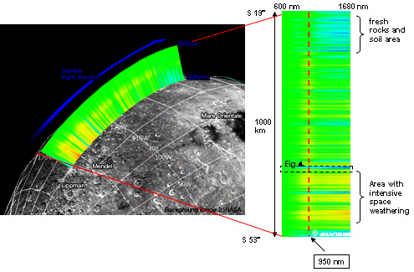
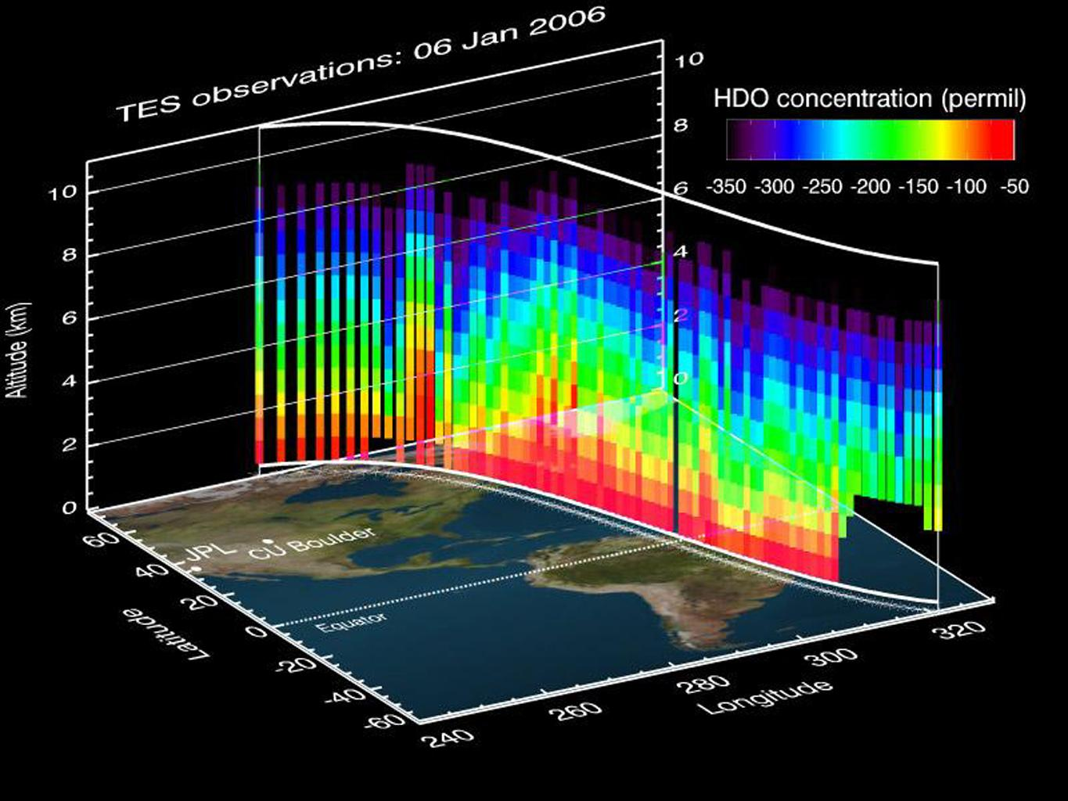
Kaguya - Spectral Profiler
SELENE = Kaguya
Lunar Orbiter
High Dimensionality Spatial Data
Notes:
The purpose of Kaguya is to spectrally map the surface of the Moon.

Slide 3

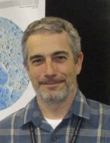

Notes:
USGS Astrogeology Science Center Located in Flagstaff Research regarding “the origins, evolutions, and geologic processes”1 of our neighboring planets, moons, and other extraterrestrial objects Jay Laura has a Ph. D. in GIScience and Geocomputation Trent Hare has an Masters in Computer Science Assist scientists in making maps

Slide 4

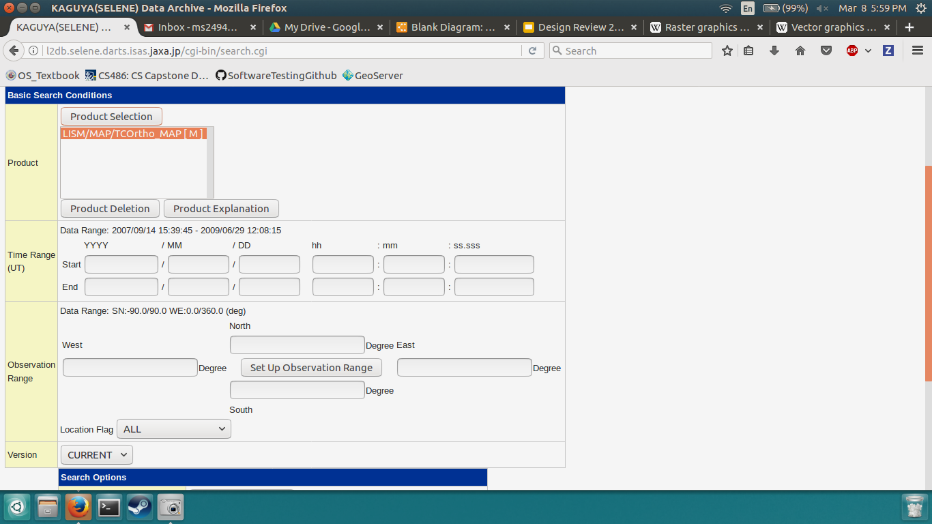
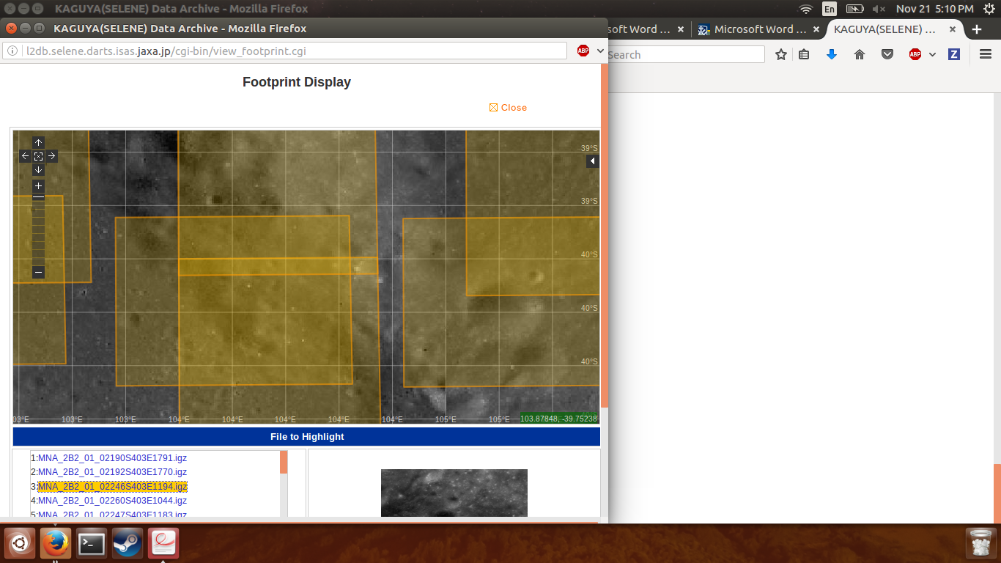
Current Methodology
Notes:
Results are aggregated by image and doesn’t allow for the automatic plotting of the data using dynamic context imagery
Does not allow for map based spatial search, or exploratory data analysis
All information must be downloaded

Slide 5
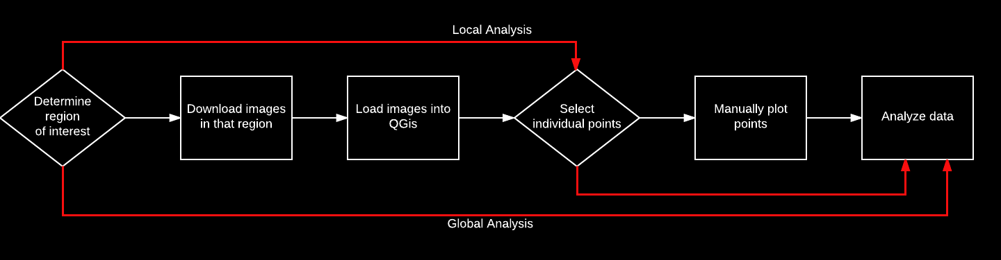
Our Solution
Kaguya Spectral Profiler Explorer (KASPER)
Visualize data
Globally
Locally
Notes:
As you can see, the current methods for accessing and analyzing this data is complex and time consuming. In order to streamline this process and make the Kaguya Spectral Profiler data more accessible, Team Selene is building a highly interactive web application for the visualization and analysis of this data. Our solution will allow for users to visualize the entire data set, as well as the specific hyperspectral data associated with each point. Our application cuts out a large portion of the overhead associated with the current system, and provides the tools to analyse the dataset in an exploratory way.

Slide 6




Technologies Overview
MongoDB
Geoserver
Node.js
Leaflet

Slide 7
Requirements
Web application interface
Support exploratory analysis
High interactivity
Visualize
Geospatial data
Hyperspectral data
Use OGC compliant technologies

Slide 8
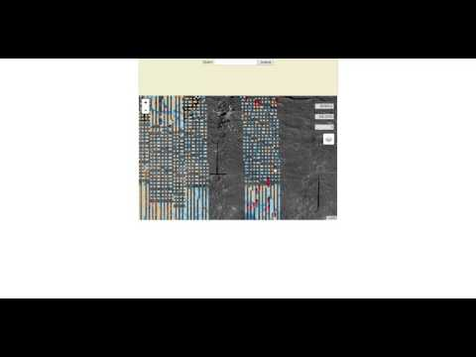

Slide 9

Architecture Overview

Slide 10
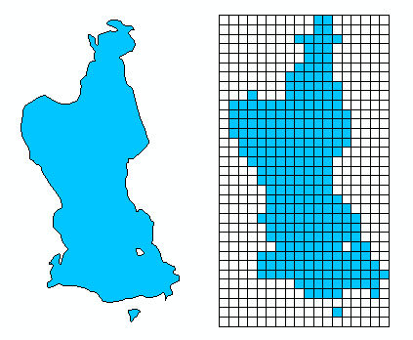
How do we make this fast?
Vector Layers
Vector
Less data zoomed in
Better resolution
Raster Layers
Bitmap
Less data global view
Poor resolution
Source: ESRI ArcGIS, http://desktop.arcgis.com/en/arcmap/10.3/manage-data/raster-and-images/what-is-raster-data.htm
Notes:
Now, how do we go about making the solution faster?
There are two ways of viewing our data: raster layers and vector layers.
A raster layer of data is like a summary. By visualizing the points into a static image, we have the advantage of generating and sending the summary on much slower connections and clients. However, this doesn’t allow much flexibility in the way of looking at individual data points, in other words the resolution.
A vector layer of data more accurately reflects the points as the individual points themselves. This allows the user to individually select the points in the context of a map, but it doesn’t take much points (beyond the thousands) to cause performance degradation on the client-side.

Slide 11
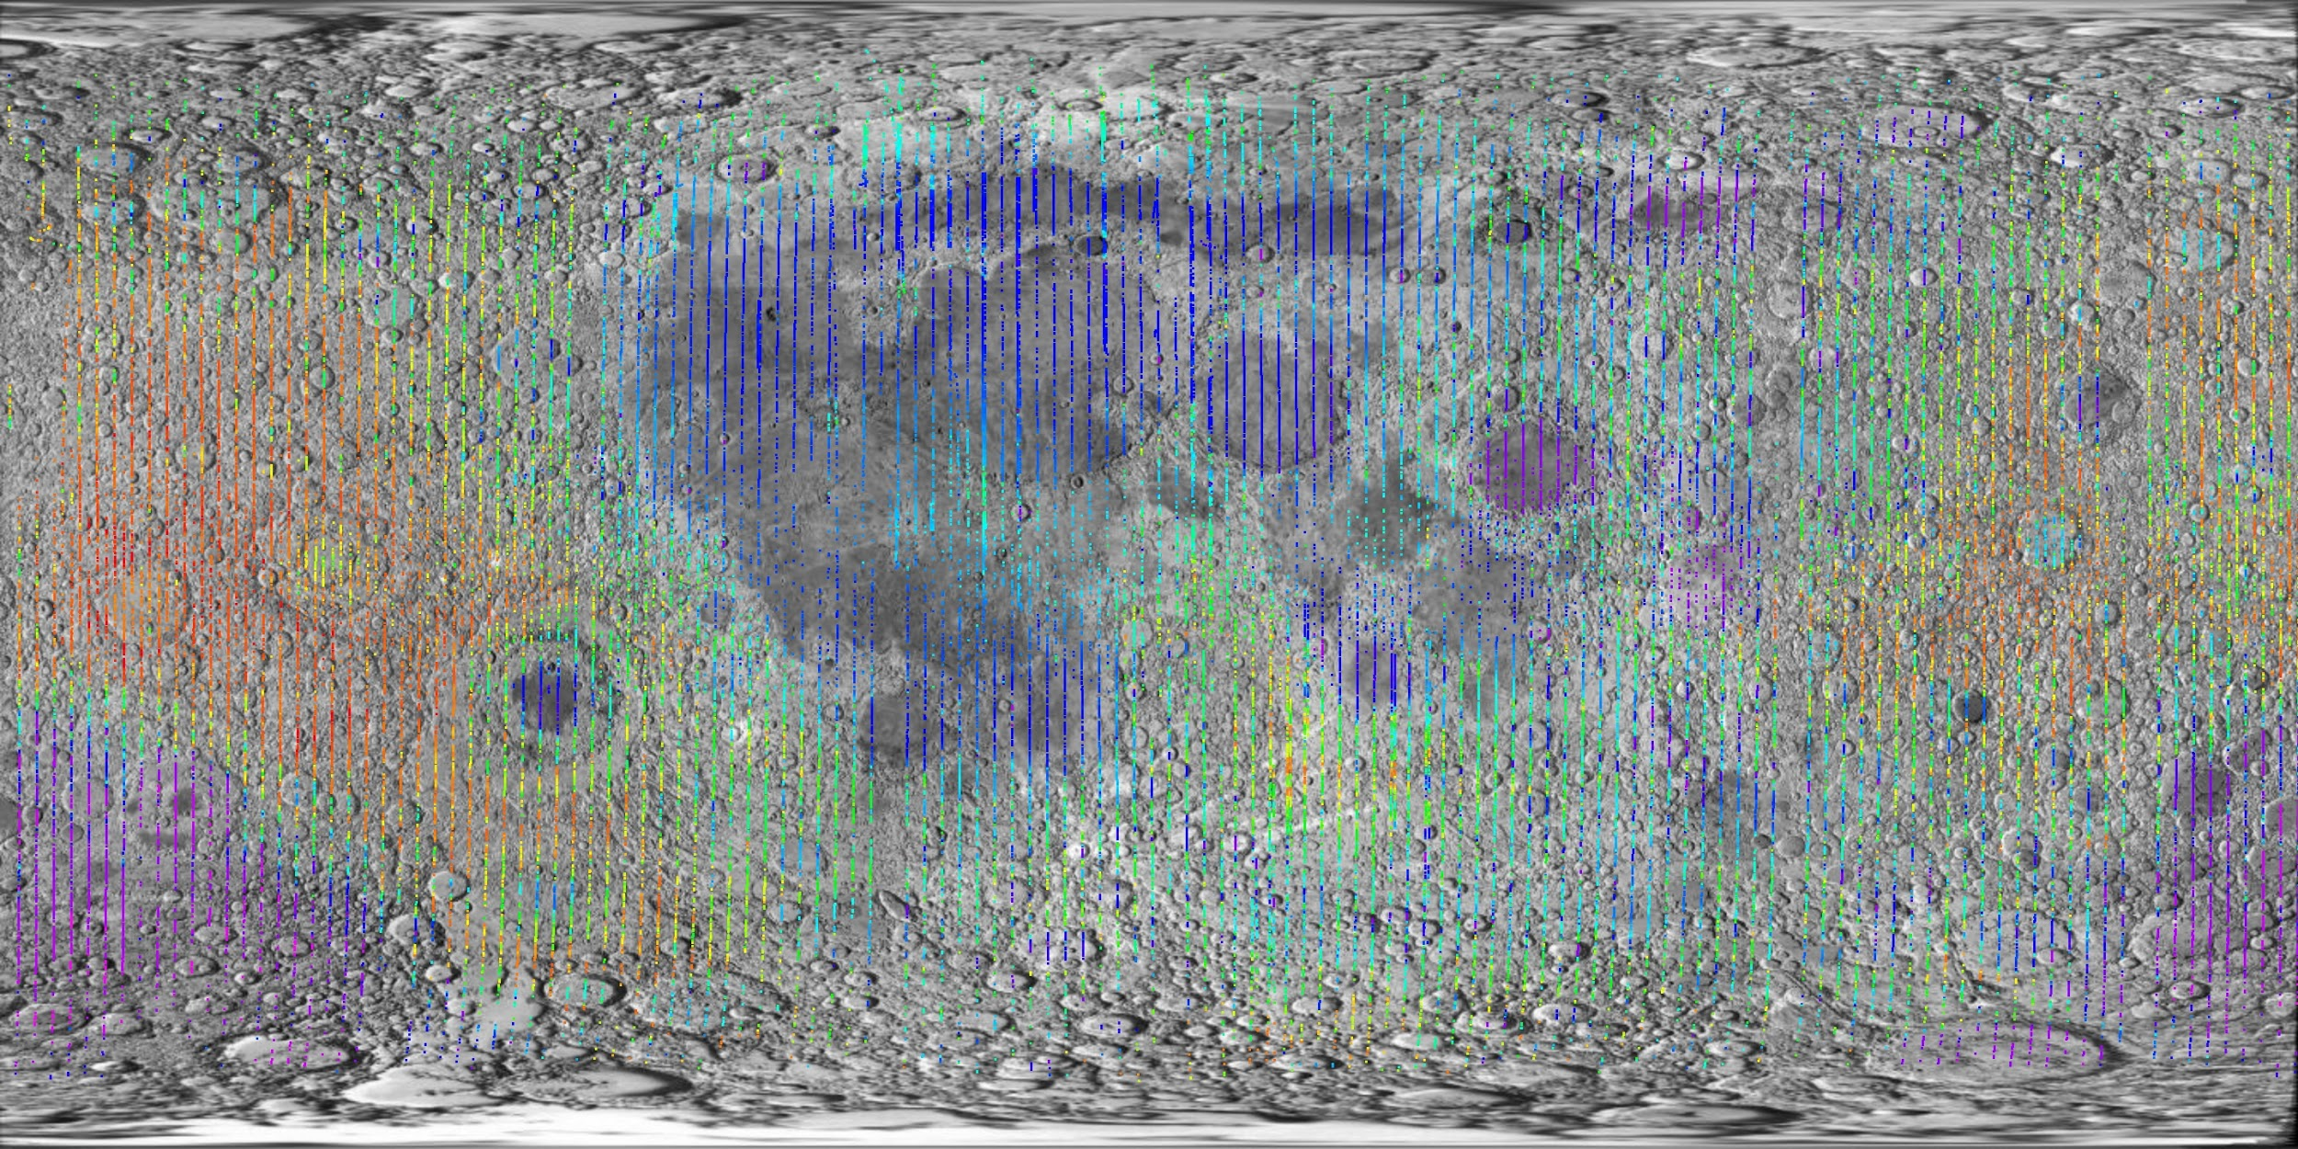
Challenges and Resolutions
Raster vs Vector
Dynamically change
gsconfig
Testing
Code testing frameworks
Mocha
Chai
Coverall
User studies
Taken from the Clementine spacecraft
(Example of a raster layer)
Notes:
One main challenge is the problem of when to use rasterized layers compared with vector layers.
Our solution is to dynamically switch between a rasterized layer and a vector layer by using the gsconfig Python library to change GeoServer’s configuration on-the-fly.
An example of a rasterized image is shown here taken by the data from the Clementine spacecraft. Our rasterized layers will look similar to this.
Another challenge is to make sure that not too much data will be sent over-the-wire when we do use a vector layer. When we’re working with a vast array of points, we need to consider the data structure we use. Our two main considerations are BSON arrays and raw hex arrays, or some combination of the two. We’ll use MongoDB to benchmark queries to get hard numbers on which is the fastest to use.

Slide 12
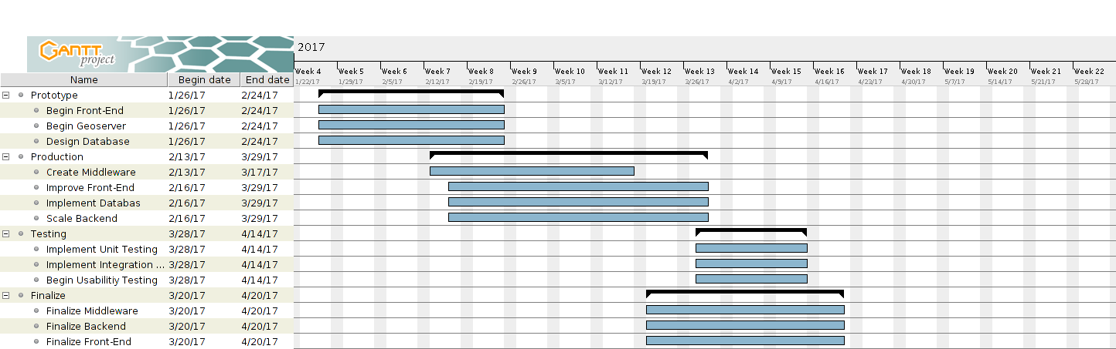
Schedule
Notes:
Basic Prototype that is full stack with leaflet and capable of looking at spectral data.

Slide 13
Future Work
Improve query controls
Expand filtering options
Polishing UI
Apply to other datasets
Notes:
Because all of the technologies we have used are Open Geospatial Consortium (OGC) compliant these is easily extendable to other datasets.

Slide 14
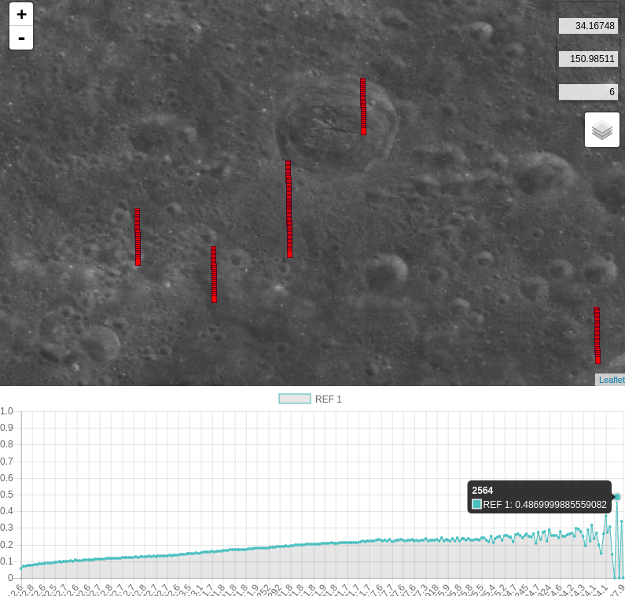
Conclusion
Kaguya data set ~1.4 terabytes
Current methods
Slow
Inefficient
Solution - KASPER
Web application
Exploratory data analysis
Automatic hyperspectral data plotting
Base layer options
Notes:
Planetary Data Conference
Thanks for listening, we would love to answer any questions.

